Slide 1


Slide 2
Welcome to the Workplace Safety and Insurance System 2023 Annual Meeting
A Renewed Path Forward

Slide 3
Agenda
Welcome/Introductions
Coordinating Committee: Priorities and Achievements
A renewed path forward: WSIS Partnership Highlights Video
Guest Speaker – Anna McBeth, Supervisor, Youth and Bridging Programs, Immigrant Services Association of Nova Scotia
Heads of Agencies: Key Initiatives
Questions and Answers

Slide 5


Slide 6


Slide 7
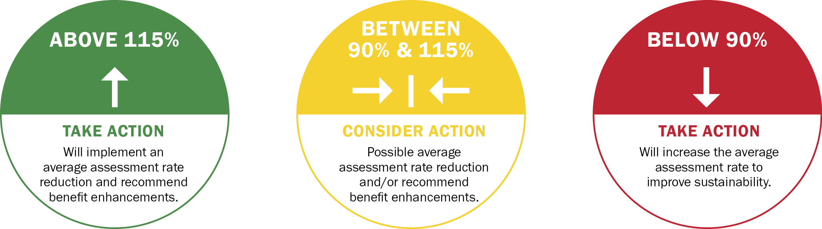
New beginnings: Our Approved Rate Range
Finally – financial sustainability has allowed a new conversation.
Assures ongoing financial sustainability, ensuring we never repeat the legacy of an underfunded system.
Give Nova Scotia’s employers and workers a clear understanding of when improvements to rates are feasible, and when we might recommend benefit changes to government.

Slide 8


Stakeholder Counselor Program Review
Update

Slide 10
Population Growth Support
Nova SAFE app
Translations of safety materials in nine languages
Hosted sessions to ensure workers are supported

Slide 11
Workers’ Compensation System Review
Review Committee
Recommendations for System Improvement

Slide 12
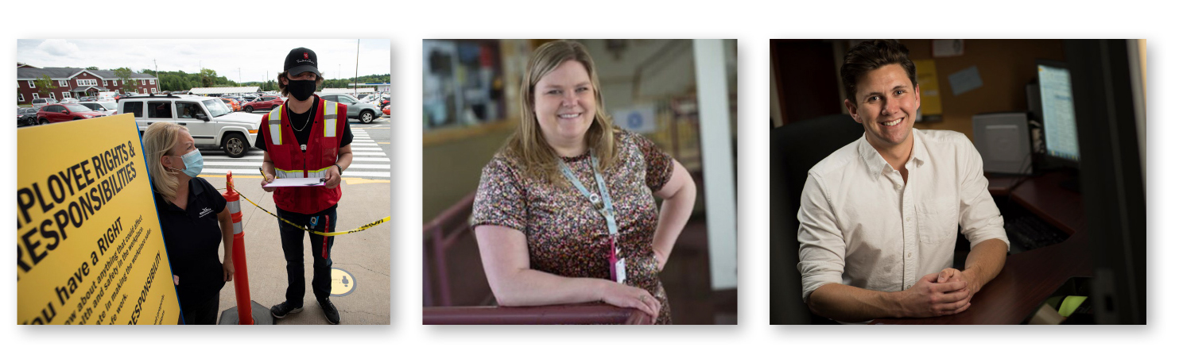
Workers’ Compensation System and
Psychological Health and Safety Consultation
WCB System Improvements
Psychological Health and Safety, with focus on Harassment
October 26 – November 29, 2023

Slide 13
Occupational Health and
Safety Advisory Committee
Focus areas for 2022–2025
Impact of COVID-19 and infectious disease on OHS
Leadership & Innovation
System Collaboration, Engagement, and Inclusion
Report on first priority being finalized

Slide 14
Welcome!
Scott Nauss
Senior Executive Director, Safety Branch
Department of Labour, Skills and Immigration

Slide 15

WSIS Highlights Video

Slide 16

Guest Speaker
Anna McBeth
Supervisor for Youth and Bridging Programs
Immigrant Services Association of Nova Scotia (ISANS)

Slide 17
Heads of Agencies Operational Highlights
Karen Adams – WCB Nova Scotia
Fred Jeffers – Safety Branch, Nova Scotia Department of Labour,
Skills and Immigration
Sandy MacIntosh – Workers’ Compensation Appeals Tribunal
Kenneth LeBlanc – Workers’ Advisers Program

Slide 18
Karen Adams – Chief Executive Officer
WCB Nova Scotia
First 45 days – Listening and Learning
Building on our progress in 2022
New ways of working together to achieve improvements
Committed to a better future

Slide 19
Fred Jeffers – Executive Director
OHS Division, Labour, Skills and Immigration
The Health Care Initiative
Fish Safe NS
Construction Safety NS – TieOFF.NS Campaign
OHS Trust Fund
The Signal Newsletter

Slide 20
Sandy MacIntosh – Chief Appeals Commissioner
Workers’ Compensation Appeals Tribunal
Timelines are improving, with more appeals resolved within a year
25% of appeals are resolved within 6 months
Current inventory of just over 500 appeals

Slide 21
Kenneth LeBlanc – Chief Workers’ Adviser
Workers’ Advisers Program
Received 733 requests for assistance
Provided service to 1772 workers
Service wait time 5.1 weeks vs target of 6 weeks
Client satisfaction 96.3%

Slide 22
Aligned Organizations
Office of the Worker Counsellor
Office of the Employer Advisor Nova Scotia
Injured Workers Association

Slide 23
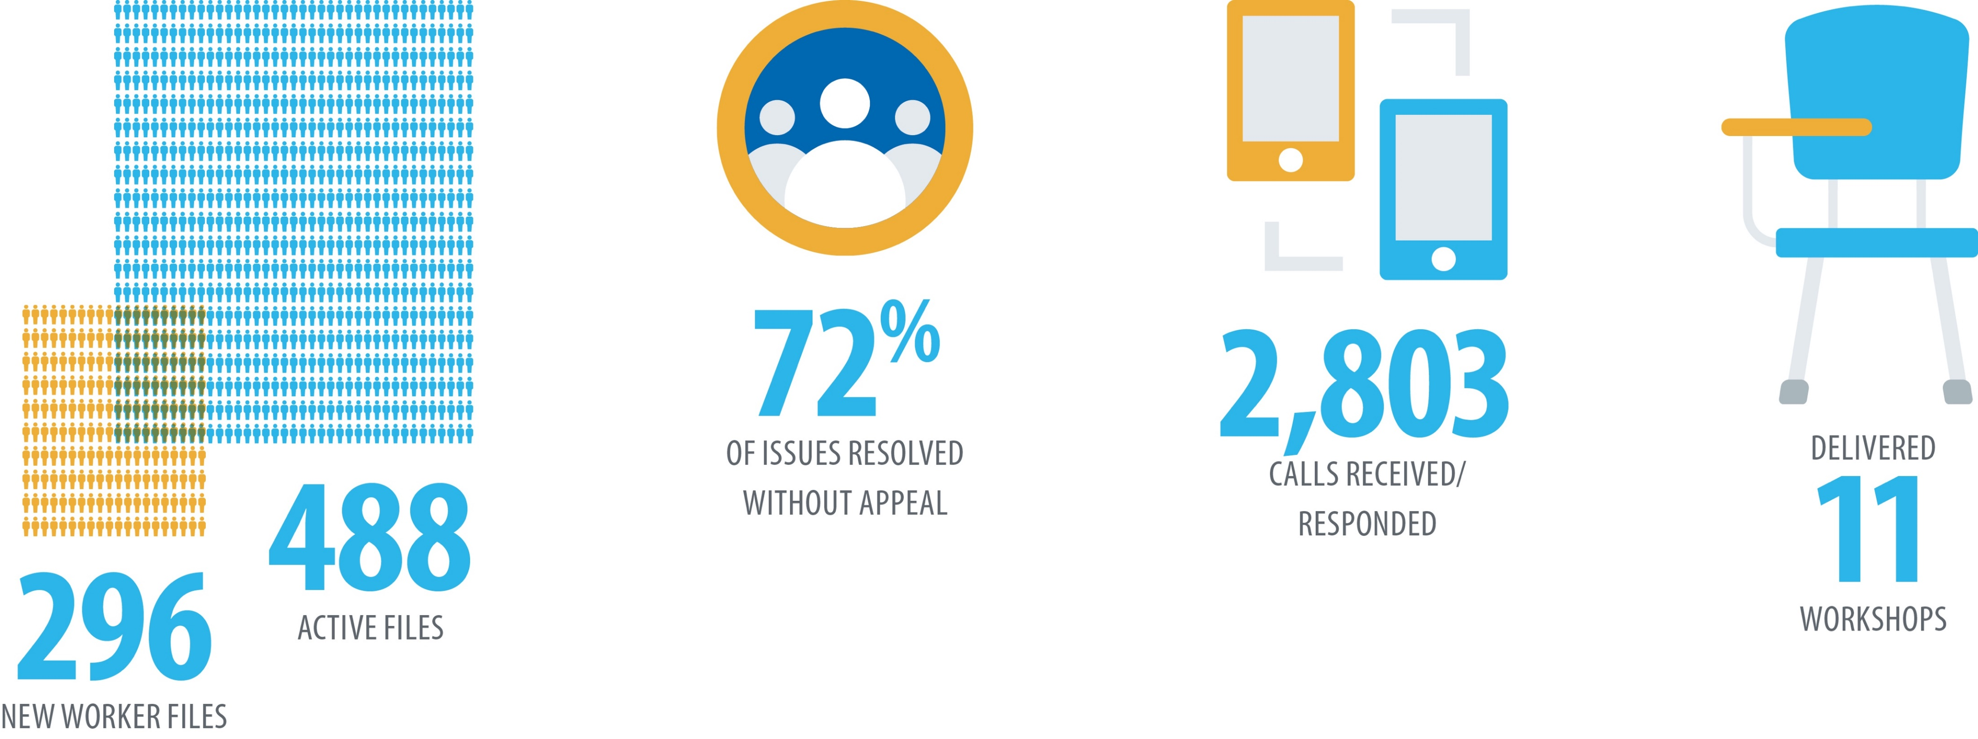
Office of the Worker Counsellor (OWC)

Slide 24
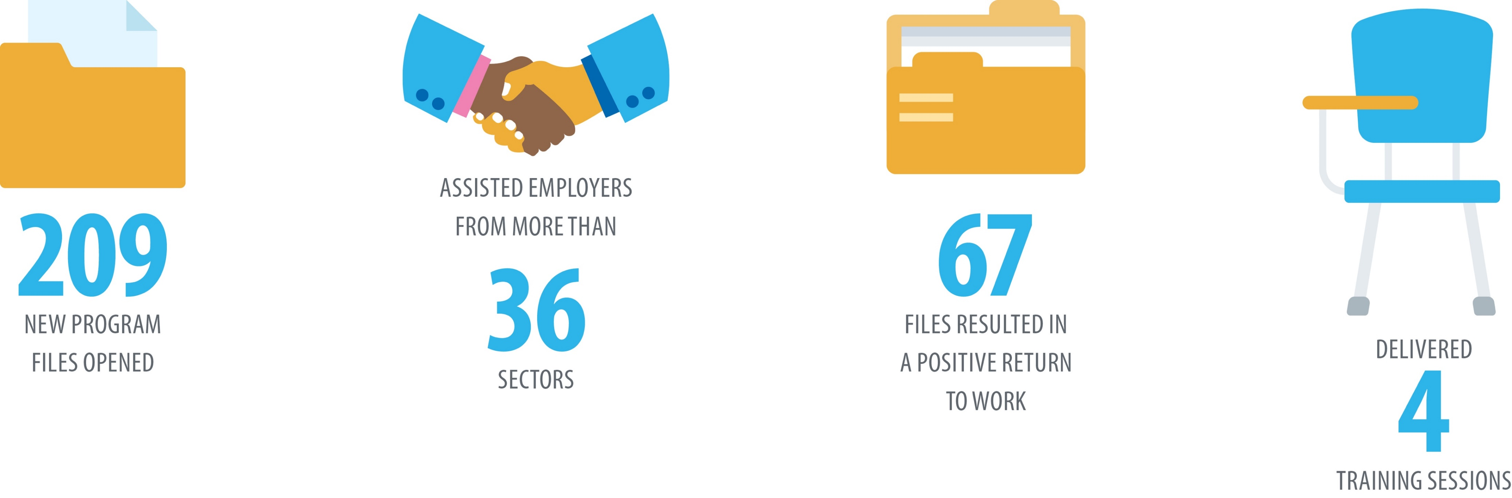
Office of the Employer Advisor NS (OEA NS)

Slide 25
Injured Workers Association
Assistance, advocacy and support to injured workers and their families
Support workers in return to work/case conferences
Assist with case management and appeals
Participate in consultations/committees

Slide 26


Slide 27
Thank you for attending the 2023 WSIS Annual Meeting
The meeting has now concluded.
Please complete our WSIS Annual Meeting Survey – available on our website, using the QR code included on the performance summary handout on each table.
Visit wsis.ns.ca for more information.

